Slide 1
Computations on sparse matrix
Netflix problem

Slide 2
Approach
Factor the given mxn user-movie matrix into two matrices (rank r < min(m,n)) representing.
r
n
m
r
movie latent features (V)
User movie matrix (M)
User latent features (U)

Slide 3
Approach – Mathematical formulation
min {|| M – UV ||_{o}} - Problem
F : R^{(m*r + n*r)} → R
s.t
Y = ||M-B||_{o} where B=UV
Y = ∑(m_{i}-b_{i})²
b_{i} € R
M is known and hence all m_{i}
This is a paraboloid in (m*r + n*r +1) dimensions.
Rank (M) = R
Rank (U) = Rank(V) = r

Slide 4
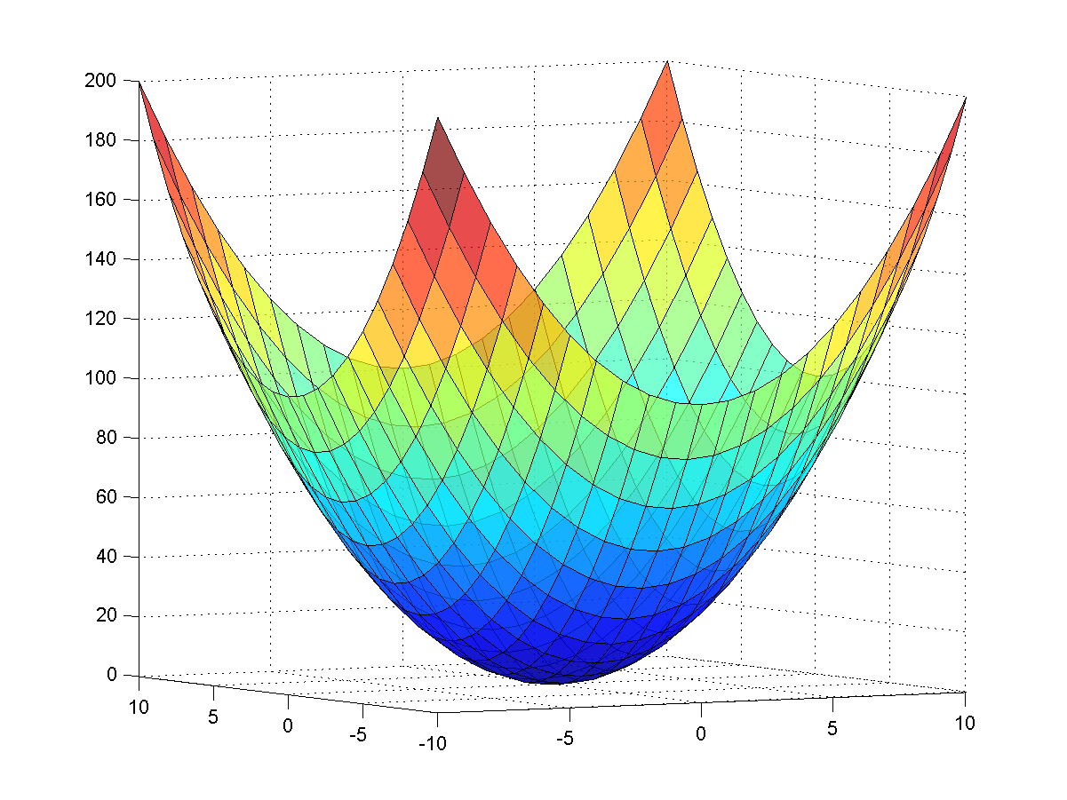
Hyperparaboloid
F : R^{(m*r + n*r)} → R
Y(U,V) = ||M-UV||_{o}
_{Or}
Y(b₁,b₂..) = ∑(m_{i}-b_{i})²

Slide 5
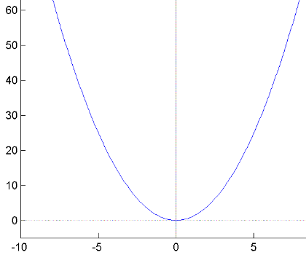
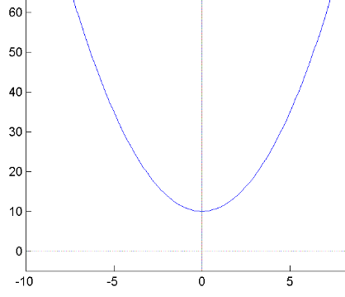
RMSE Difference - Ranks
r >= R
r < R
RMSE Difference M-UV
(m*r + n*r) dimensional space

Slide 6
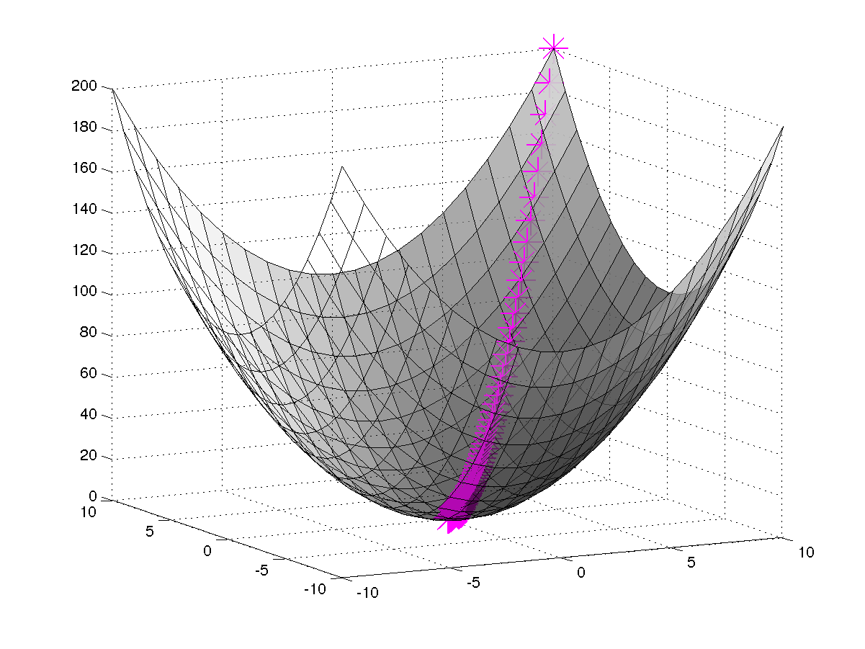
Gradient Descent
Gradient Descent cover the two types of gradient descent

Slide 7
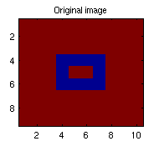
Abstractions – M
0
n
m
64
User movie matrix
9 x 10

Slide 8
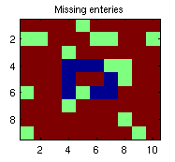
M_missing
0
n
m
CODE k = randint(l,1,(a(1)*a(2))-1)+1;
M_missing = M;
M_missing(k)=32;
9 x 10
64
32

Slide 9
u_approx_missing
Can be thought of as a matrix containing latent features of users
CODE
a = size(M) u_approx_missing = randint (a(1),r,5);
r latent features
m users
9 x r

Slide 10
v_approx_missing
Similarly the other matrix is movie matrix representing the latent features of movies.
CODE
a = size(M) v_approx_missing = randint (r,a(2),5);
r latent features
n movies
10 x r

Slide 11
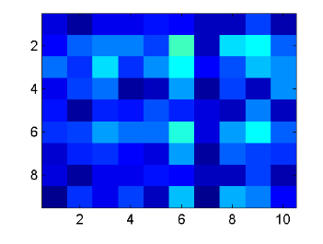
M_approx_missing
n
m
9 x 10
CODE M_approx_missing = u_approx_missing * v_approx_missing;

Slide 12
Inputs
variable | Description
R | Rank of matirx to be approximated u_missing_approx (mxr) v_missing_approx(nxr)
l_lim | Value upto which program will sparse and calculate RMSE of the matrix (staring from 1)
Lrate | Learning rate (0.002)
M | Input Matrix
mc_itr | Monti carlo iterations to perform
fro_th | Threshold of frobinius norm

Slide 13
Goals – The RMSE curve
RMSE Curve is graph bw RMSE difference vs sparseness.
Expected RMSE difference between the original and approximated matrix for :::
Same matrices
When the matrix is permutated
No effect – proved by experiment (by dropping columns)
As r varies
Different matrices (ratio of rank vs dimension)
Rectangle
Circle
Time curves

Slide 14
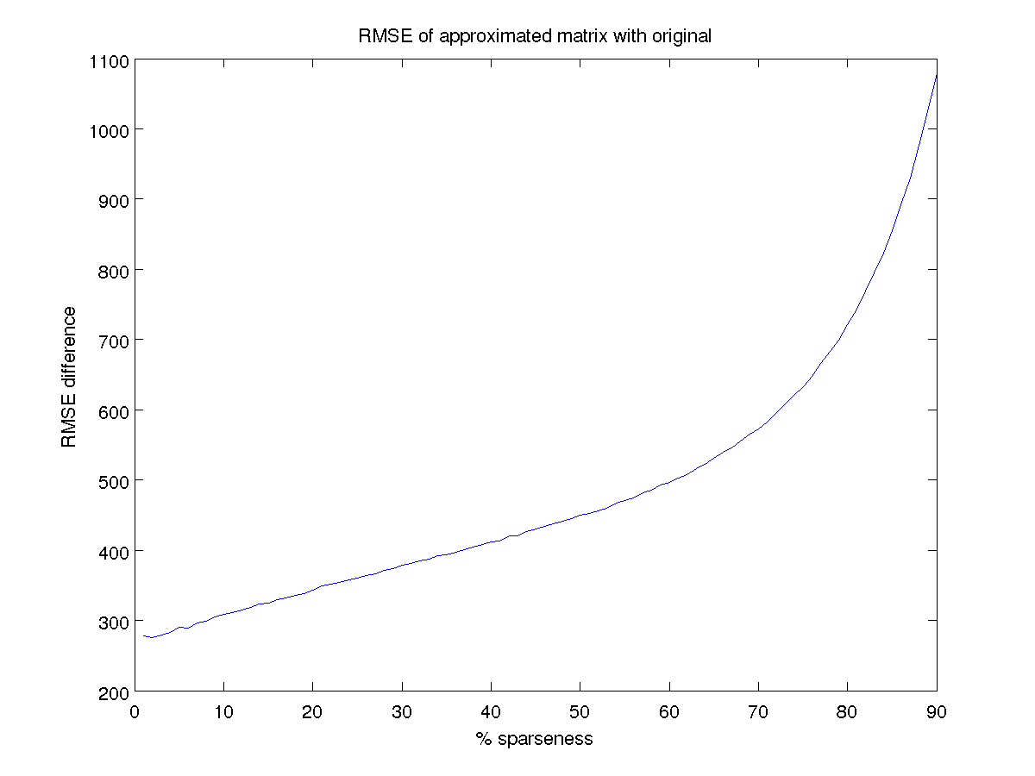
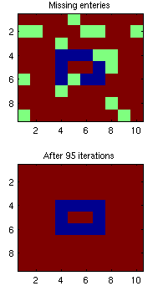
RMSE Curve - Rectangle
R=80, mc_itr =25000 l_lim= Time ~ 6 hrs

Slide 15
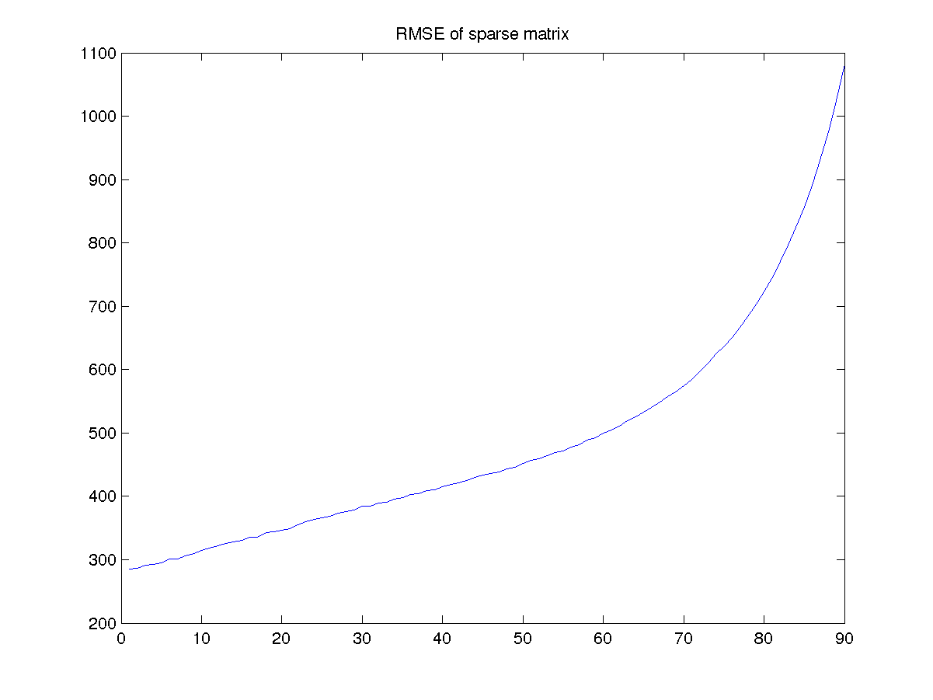
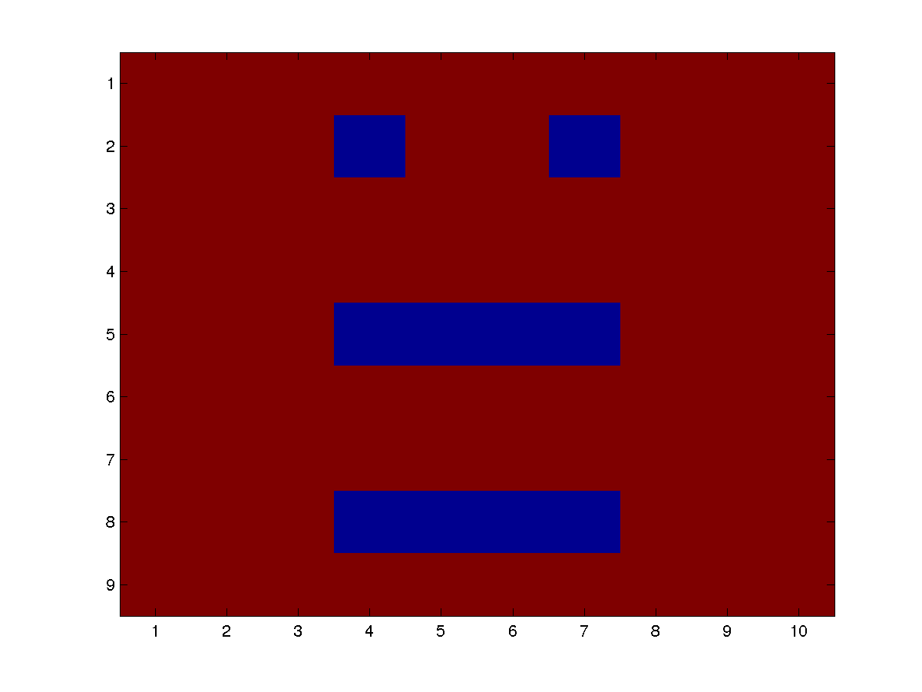
Rectangle - permuted
R=80,
mc_itr =25000
l_lim=90
Time ~ 6 hrs
Notes:
Label the graph properly and add the other curve in the figure

Slide 16
Permutated - closer look

Slide 17
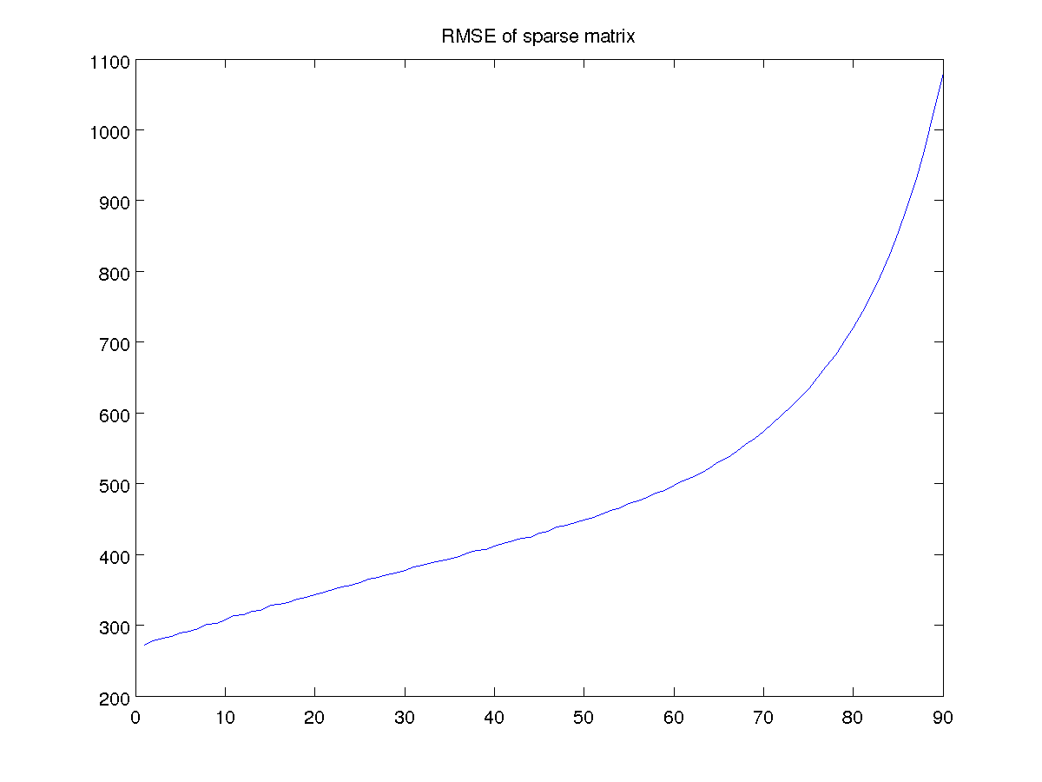
Rectangle – variation of r(80)
Notes:
Do proper labeling of axis and make ylim and xlim as same….

Slide 18
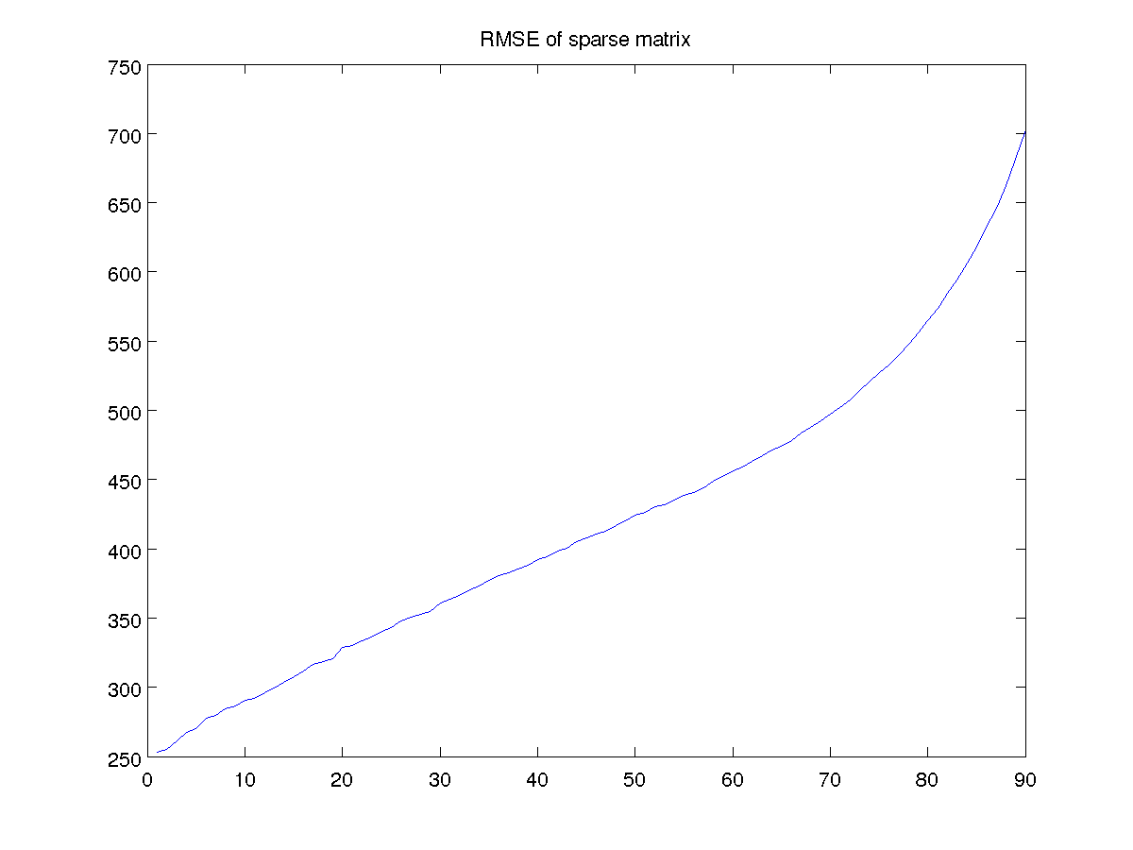
Rectangle – variation of r(70)

Slide 19
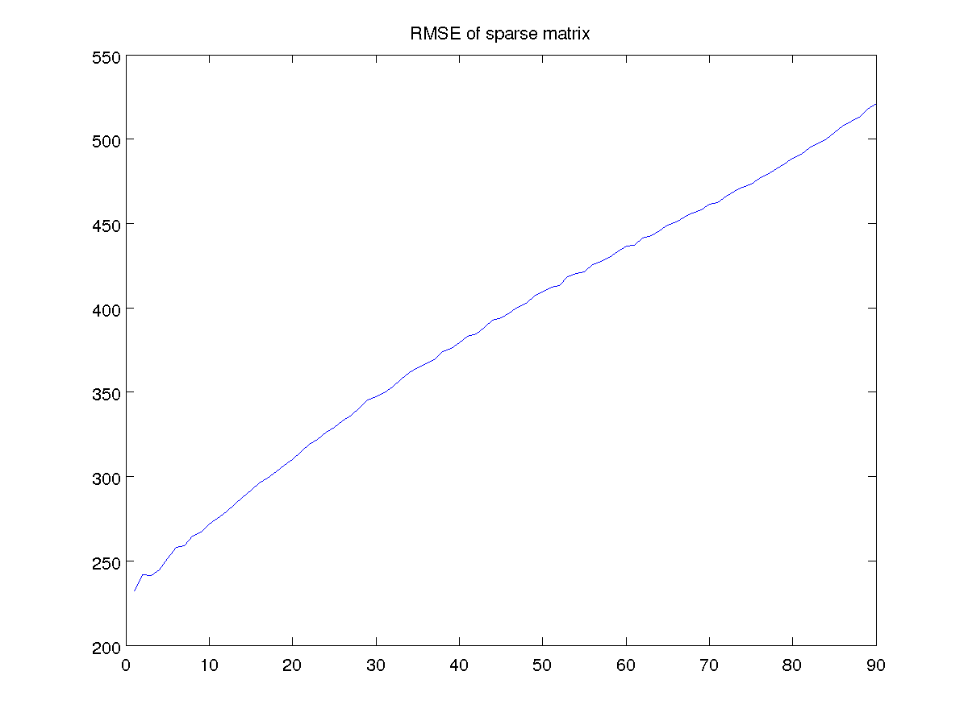
Rectangle – variation of r(60)

Slide 20
Variation – in a nutshell

Slide 21
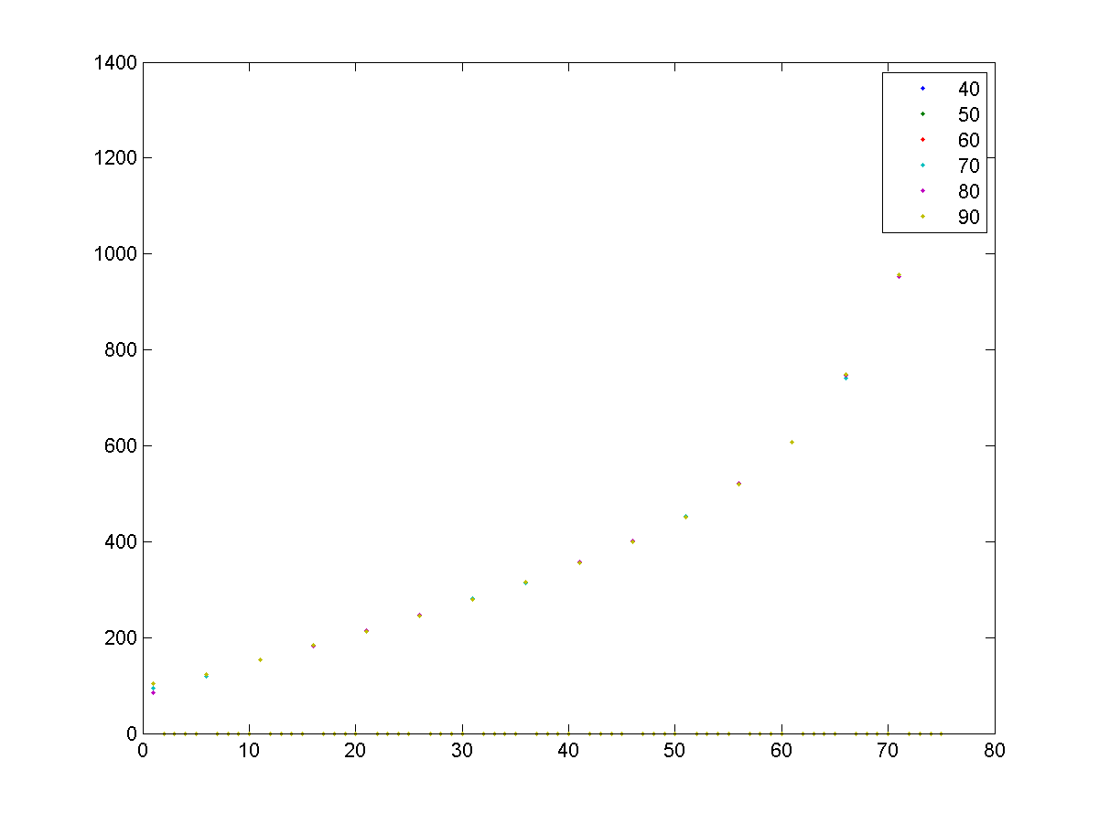
Variation – in a nutshell

Slide 22
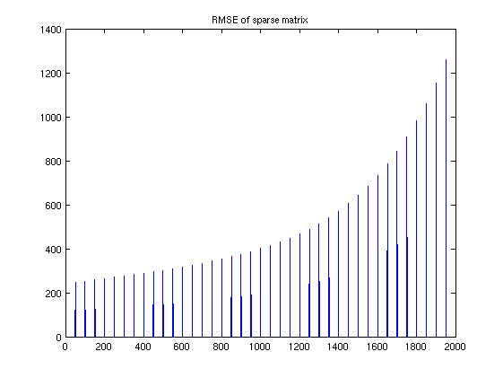
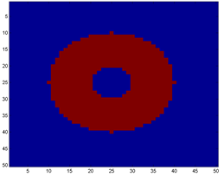
RMSE Curve – Circle
Rank = 13
Greater than 0 =640
Equal to zero = 1860
R=260
mc_itr =13000
l_lim= 2000/50
Time ~ 43hrs

Slide 23
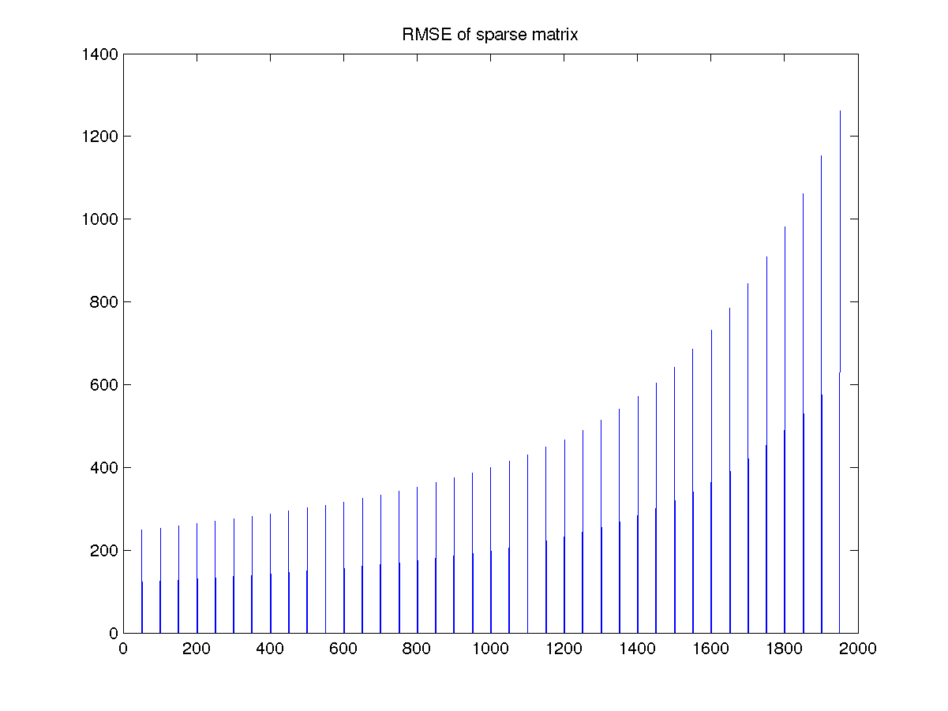
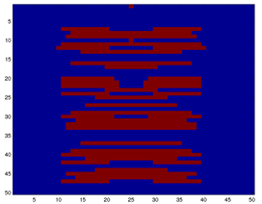
Circle - permuted
R=260
mc_itr =10000
l_lim= 2000/50
Time ~ 40hrs

Slide 24
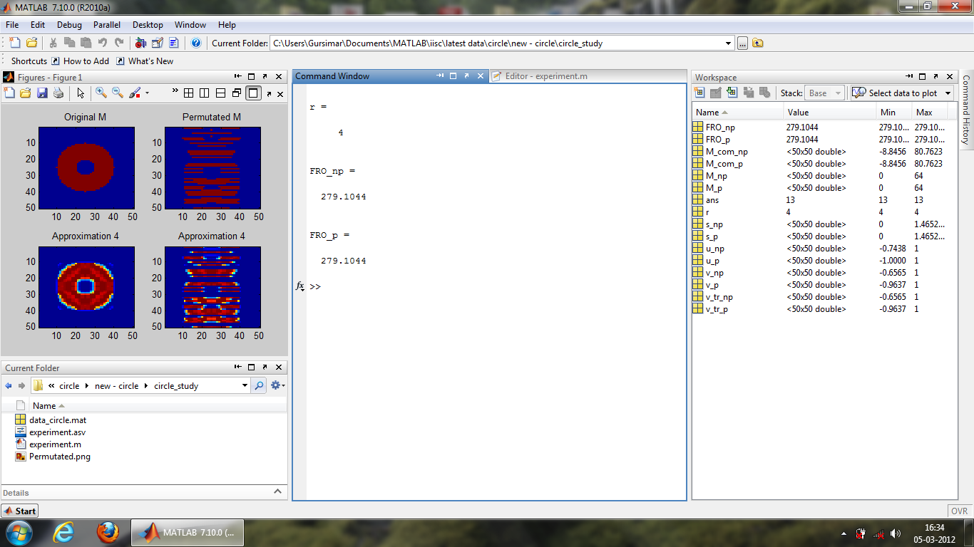
By dropping columns (SVD)

Slide 25
New questions
How close I can reach by gradient descent method.
What happens when no entry is missing
FRO_diff =
How does starting point affects the result.
Best is to study the case for l=0

Slide 26
New questions
Study for lower rank r<R

Slide 27
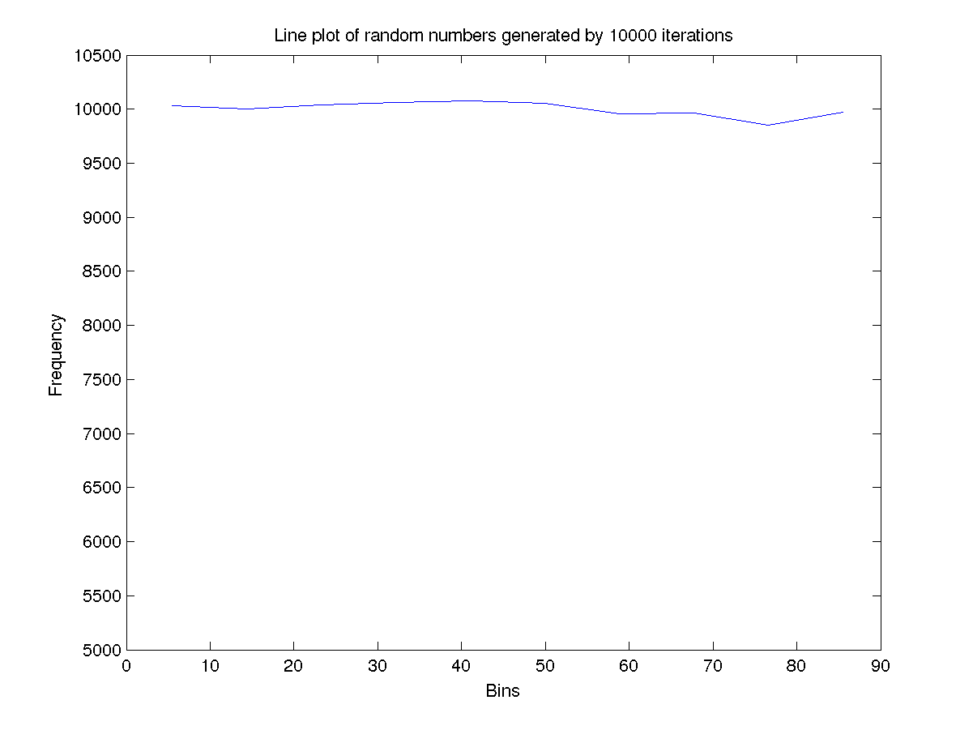
Testing – Random number generator

Slide 28
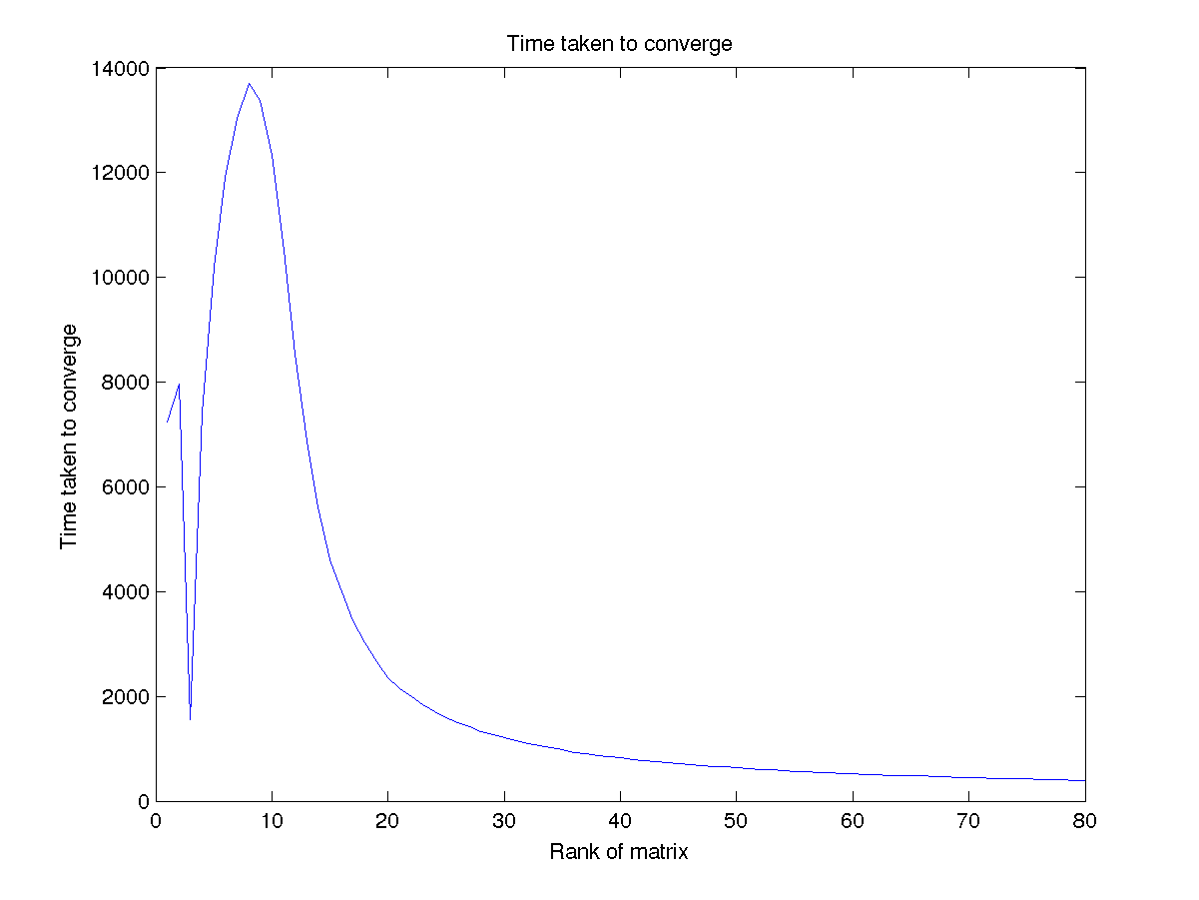
Testing – Time vs r (Rectangle)

Slide 29
Other possible options
Time curve of convergence as r
Do this remains same for other matrices.
Explain the curve.

Slide 30
Other possible options
PSO on the matrix space to find min.
On dense matrix
On sparse matrix
Look for papers
Possible improvements of the matrix factorization method of simon funk.
Look for papers.

Slide 31
Comparison of two methods
Simon funk’s method was based on a particular dataset, so no need for monticarlo to get stable RMSE curve. Instead he will get only one value of RMSE.
The particular dataset always have the same missing entries, so in a way they are working only on one sparse matrix.
This makes comparison of methods easy because if we introduce some modification to method, there is no chance that it may produce some adverse effects on other possible sparse matrices (which does not exist here).

Slide 32
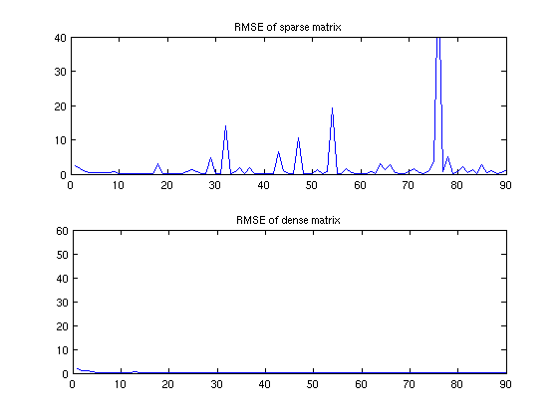
Other figures
RMSE with one iteration (Rectangle r=80,l_lim=90)

Slide 33
Rough work
Explain the permutation results analytically and logically..
Explain the r>R cases in the same way.
Make the theory mathematically sound.
Explain the eckart n young theorm with intuition
Explain why its finding missing entries..
Add related figures..

